Slide 1
Statistical / Dynamical Intensity Models
SHIPS (Statistical Hurricane Intensity Prediction Scheme)
Multiple regression model
Predictors from climatology, persistence, atmosphere and ocean
  Atmospheric predictors from GFS forecast fields
  SST from Reynolds weekly fields along forecast track
  Predictors from satellite data
    Oceanic heat content from altimetry
    GOES IR window channel brightness temperatures
Decay SHIPS
  Climatological wind decay rate over land
Notes:
ANNUAL UPDATE: Send to M. DeMaria to verify current SHIPS configuration
**Last Updated June 2014 by AS

Slide 2
The SHIPS Model Predictors*
(+) SST POTENTIAL (VMAX-V): Difference between the maximum potential intensity (depends on SST) and the current intensity
(-) VERTICAL (850-200 MB) WIND SHEAR: Current and forecast, impact modified by shear direction
(-) VERTICAL WIND SHEAR ADJUSTMENT: Accounts for shear between levels besides 850 and 200 hPa
(+) PERSISTENCE: If TC has been strengthening, it will probably continue to strengthen, and vice versa
(-) UPPER LEVEL (200 MB) TEMPERATURE: Warm upper-level temperatures inhibit convection
(+) THETA-E EXCESS: Related to buoyancy (CAPE); more buoyancy is conducive to strengthening
(+) 500-300 MB LAYER AVERAGE RELATIVE HUMIDITY: Dry air at mid levels inhibits strengthening
(-) 850-700 MB TEMPERTURE ADVECTION: Cold air advection favors intensification during ET transition
*Yellow text indicates most important predictors
Notes:
ANNUAL UPDATE: Send to M. DeMaria to verify current SHIPS configuration
**Last Updated June 2014 by AS

Slide 3
The SHIPS Model Predictors (Cont…)
(+) 850 MB ENVIRONMENTAL RELATIVE VORTICITY: Vorticity averaged over large area (r <1000 km) – intensification favored when the storm is in environment of cyclonic low-level vorticity
(+) GFS VORTEX TENDENCY: 850-hPa tangential wind (0-500 km radial average) – intensification favored when GFS spins up storm
(-) ZONAL STORM MOTION: Intensification favored when TCs moving west
(-) STEERING LAYER PRESSURE: intensification favored for storms moving more with the upper level flow – this predictor usually only comes into play when storms get sheared off and move with the flow at very low levels (in which case they are likely to weaken)
(+) 200 MB DIVERGENCE: Divergence aloft enhances outflow and promotes strengthening
(-) CLIMATOLOGY: Number of days from the climatological peak of the hurricane season
*Yellow text indicates most important predictors
Notes:
ANNUAL UPDATE: Send to M. DeMaria to verify current SHIPS configuration
**Last Updated June 2014 by AS

Slide 4
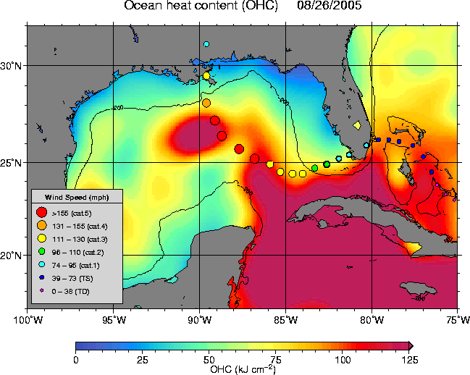
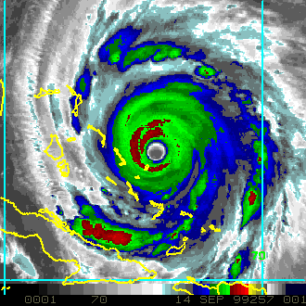
Satellite Predictors added to SHIPS in 2003
1. GOES cold IR pixel count
2. GOES IR T_{b} standard deviation
3. Oceanic heat content from satellite altimetry
(NHC/UM algorithm)
Cold IR, symmetric IR, high OHC favor intensification
Notes:
ANNUAL UPDATE: Send to M. DeMaria to verify current SHIPS configuration
**Last Updated June 2014 by AS

Slide 5
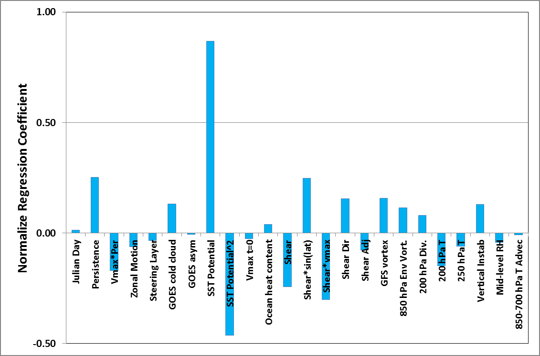
Factors in the Decay-SHIPS Model
Center Over Water
Normalized Regression Coefficients at 48 hr for the 2014 Atlantic SHIPS Model
Notes:
ANNUAL UPDATE: Ask M. DeMaria to send current SHIPS predictor coefficients (text file). Update Excel “NHC_VISIT_plot.xls” spreadsheet “48h_SHIPS_Coef”.
**Last Updated June 2014 by AS

Slide 6
Factors in the Decay-SHIPS Model
Center over Land
Adjusts over-water SHIPS forecast using empirical exponential decay formula
Depends on time inland and fraction of area out to 110 km over land
SHIPS and Decay-SHIPS forecasts for Hurricane
Dolly starting at 00 UTC 23 July 2008
(Forecasted landfall at t=16 hr)
Notes:
ANNUAL UPDATE: Send to M. DeMaria to verify current SHIPS configuration
**Last Updated June 2014 by AS

Slide 7
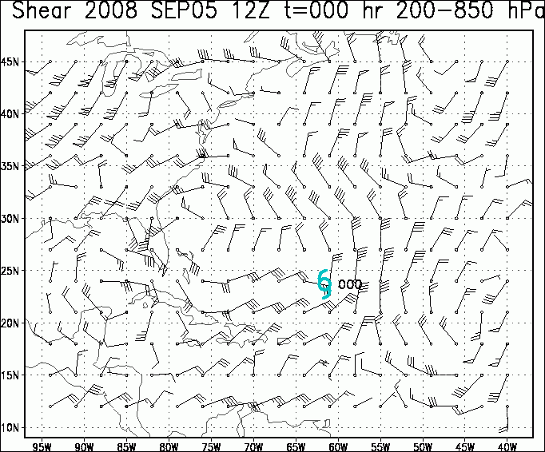
Regions with Most Favorable
Shear Directions for Hurricane Ike
(New SHIPS Model Predictor for 2009)
Notes:
Note: shows NE shear favorable in low latitudes, SW shear in high latitudes

Slide 8
The Logistic Growth Equation Model (LGEM)
Applies simple differential equation to constrain the max winds between zero and the maximum potential intensity
  Based on analogy with population growth modeling
Intensity growth rate predicted using SHIPS model input
More responsive than SHIPS to time changes of predictors such as vertical shear
More sensitive track errors
More difficult to include persistence
Notes:
ANNUAL UPDATE: Send to M. DeMaria to verify current LGEM configuration
**Last Updated June 2014 by AS

Slide 9
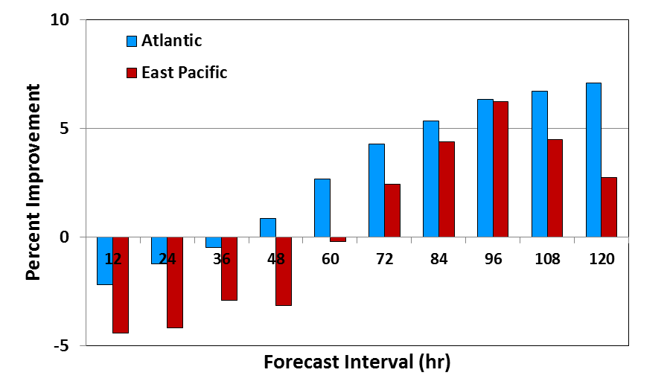
LGEM Improvement over SHIPS
2006-2013 Operational Runs
Notes:
ANNUAL UPDATE: Ask M. DeMaria to send most recent error statistics for SHIPS and LGEM (text file). Update Excel “NHC_VISIT_plot.xls” spreadsheet “Ver_DSHP_vs_LGEM”.
**Last Updated June 2014 by AS

Slide 10
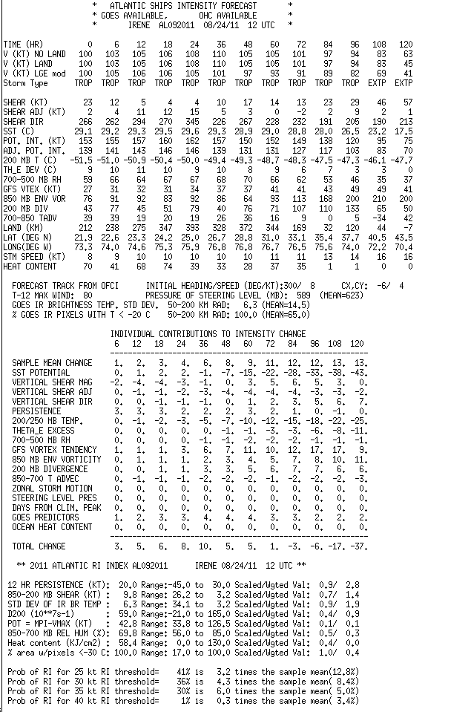
SHIPS text output file
SHIPS and LGEM forecasts
Predictor information
Additional features
  Rapid Intensification Index
  Storm classification
    Tropical, Subtropical or Extra-Tropical
    Discriminant analysis with storm feature, GFS forecast input
Note: SHIPS and RII output available
on-line in real time
ftp://ftp.nhc.noaa.gov/atcf/stext

